Slide 1
Demo of Deriving new use cases based on link prediction algorithm for FG AN use cases
By: Tarek Mohamed
Activities are done as part of ITU FG AN Build-a-thon 2022
Presented during Workshop 3.0
7 Nov 2022

Slide 2
Contents:
1. parse use cases
2. Create graph
Document Parsing
Graphs Parsing
Graph database representation.
Link Prediction.
3. Analyse graph
4. Update graph

Slide 3
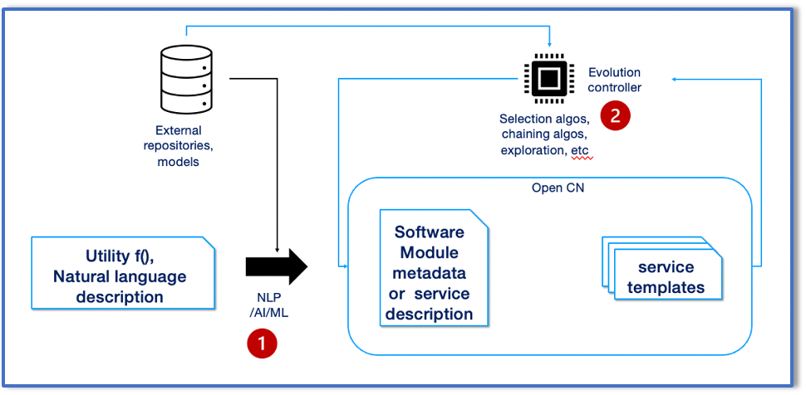
Document Parsing:
Aim of this task is to parse the use cases word document (FGAN-O-013R1)
Corresponding to the task (1) in the figure, we use Docx library to parse the document.
following are the steps:
Selecting the appropriate tables.
Get the information From Tables.
Get the use cases’ requirements in a dataframe.
Figure from FGAN-I-267
Step-1: to parse and read the tables
Step-2: to create a table format which can be analysed offline.

Slide 4
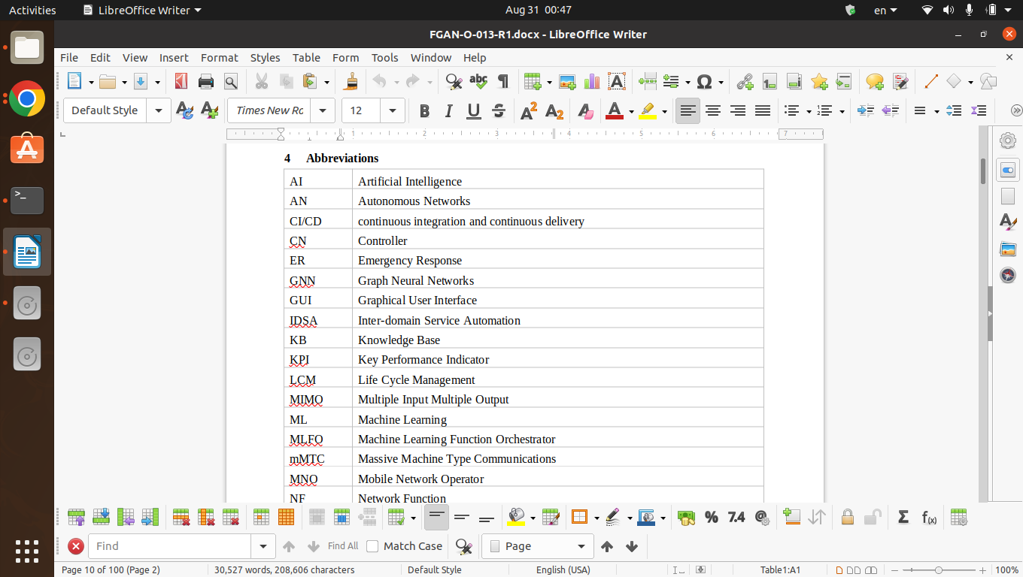
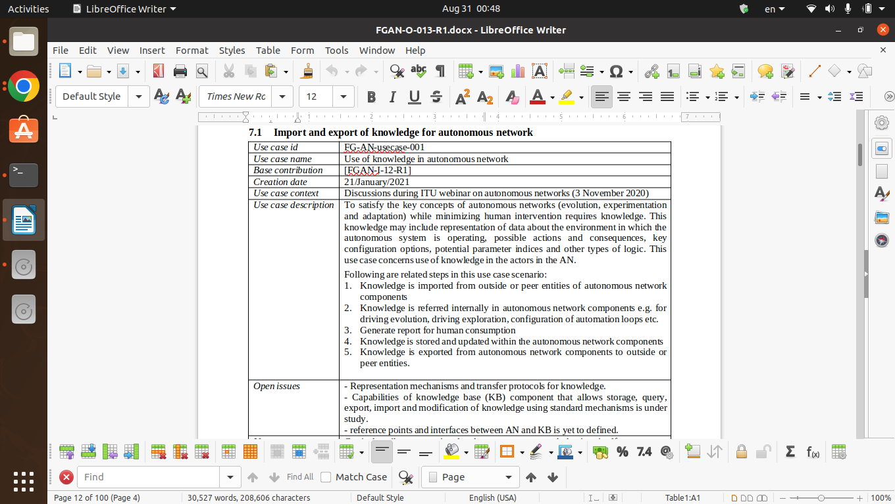
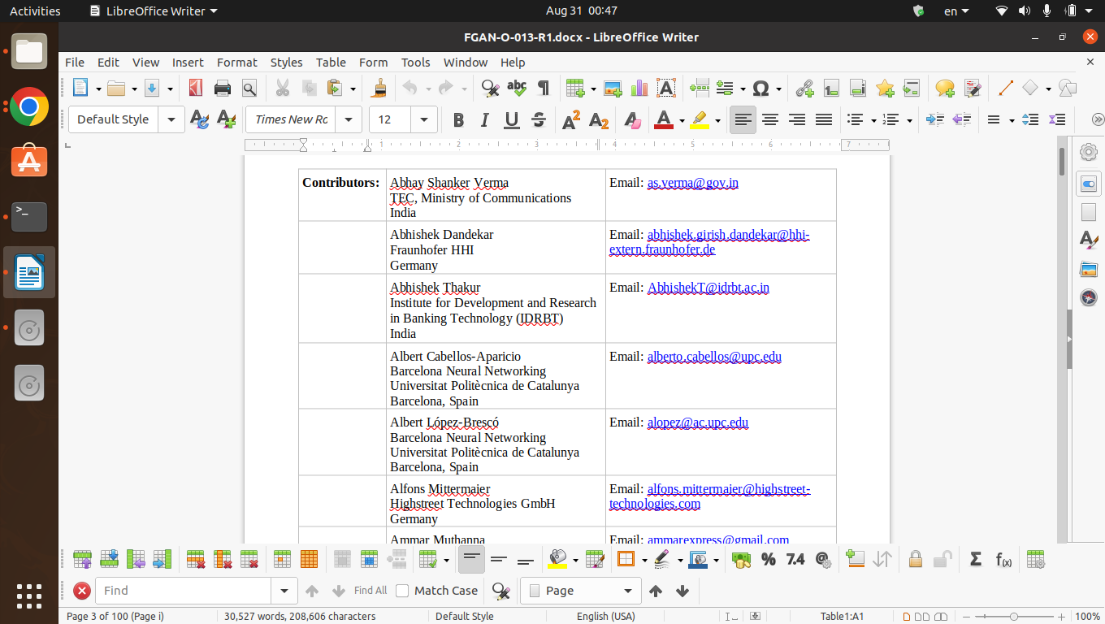
1.1. Parsing the tables:
The document has a lot of tables like:
Use Cases Tables
Abbreviations table:
Contributors tables:

Slide 5
Focussing on the use cases tables
Need to make a condition on the first two cells (first row).

Slide 6
1.2 Getting the information:
The problem: The inconsistency of naming the properties of the table, Like:
[Category, Use case category, Notes on use case category] they all refer to the category of the use cases.
[Base contribution, Base Contribution, Base contributions] All refers to the same information.
[Use case description, Description, Use case description\n] All refers to the same information.
[Open issues, Open issues (as seen by the proponent)] All refers to the same information.
The Solution: Collate one column from the combination of all columns that represents the same information.

Slide 7
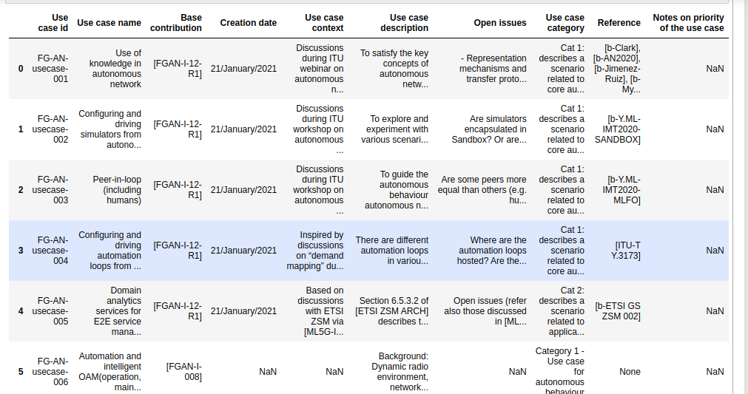
Example - Final parsed data from the tables:

Slide 8
1.3 Parsing Requirements:
Each use case has some requirements and these requirements has 3 categories:
Critical: Important and required for the use cases implementation.
Expected: Possible requirement which would be important but not absolutely necessary to be fulfilled.
Added Value: possible requirement which would be optional to be fulfilled (e.g., by an implementation), without implying any sense of importance regarding its fulfilment.
Step-1: to parse and read the requirements
Step-2: to create a table format which can be analysed offline.

Slide 9
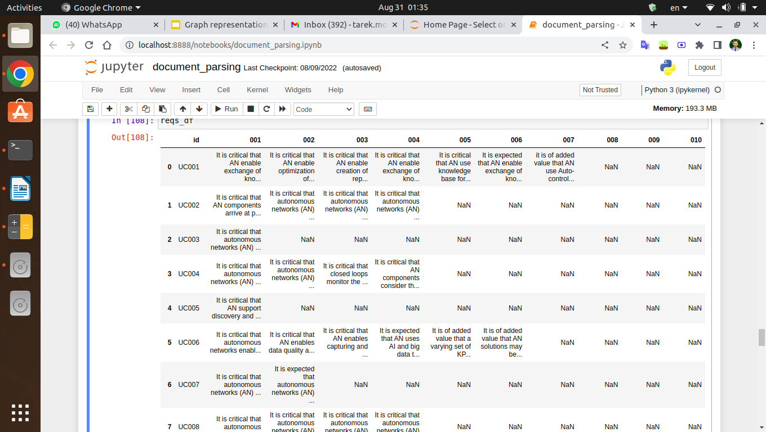
Example - Final requirements parsed from the document:

Slide 10
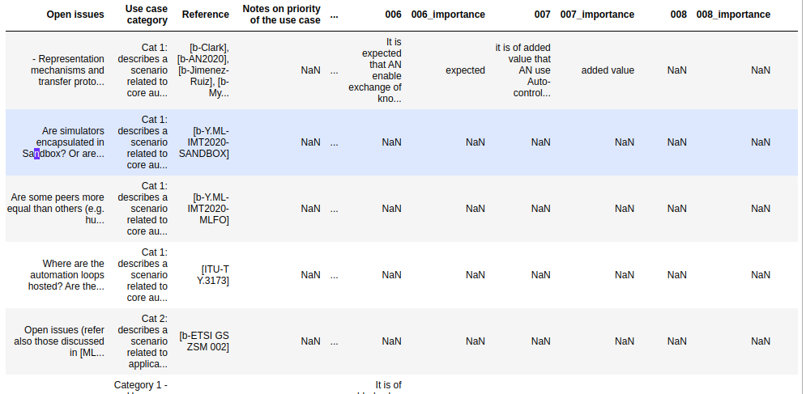
Final Table from requirements and use cases:

Slide 11
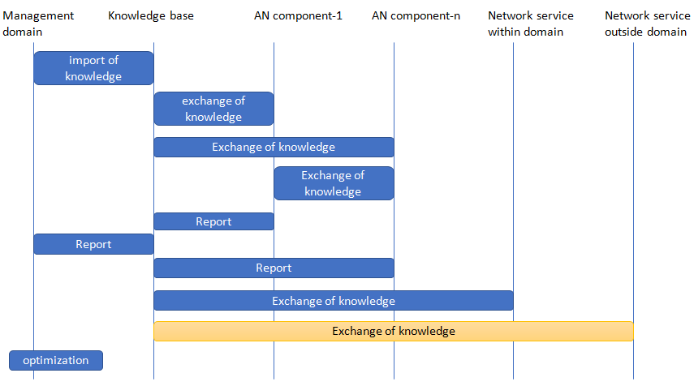
2. Figure Parsing:
We have two kinds of figures in the document:
1. Actor interaction diagrams

Slide 12
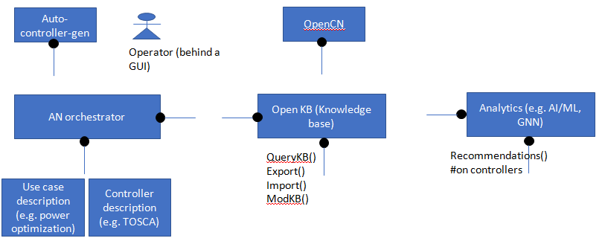
2. Possible components

Slide 13
Step-1: to represent the figures in machine-readable format
The problem: These figures are not parsable so we need to change it to a parsable format.
The solution: We Tried two tools and choosed the best:
PlantUML
Draw.io
Step-2: to parse the figures in the machine-readable format
Step-3: to create a table format which can be analysed offline.

Slide 14
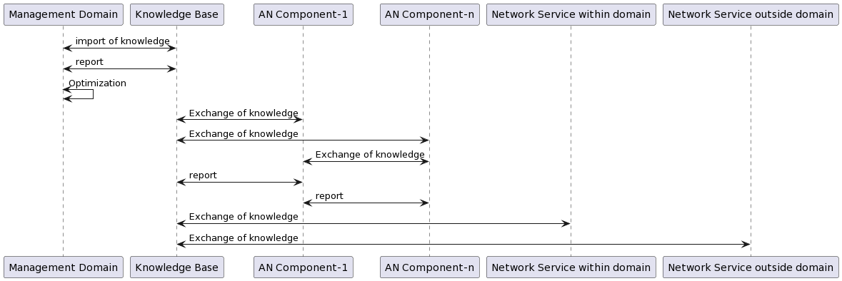
2.1 PlantUML:
2.1.1 First Try:

Slide 15
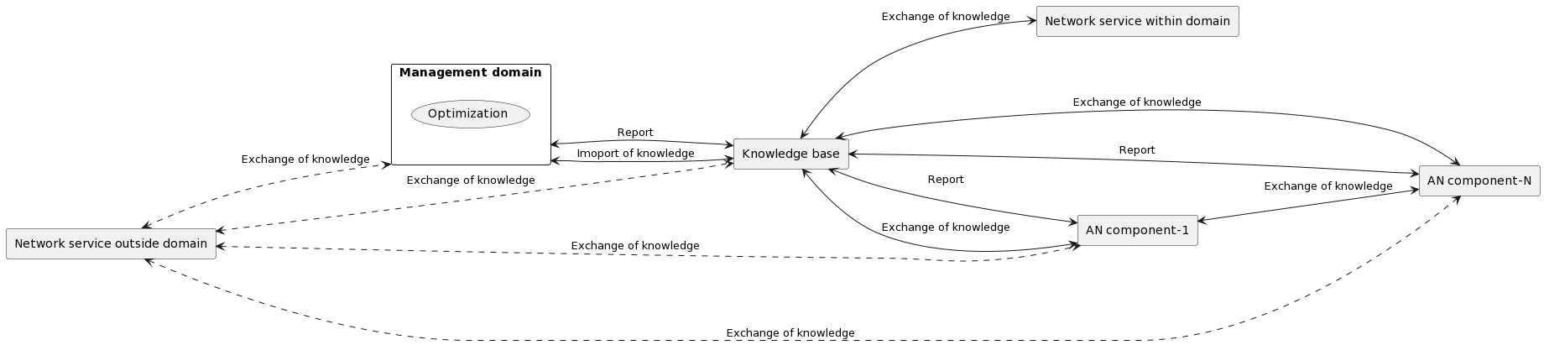
2.1.1 Second Try:

Slide 16
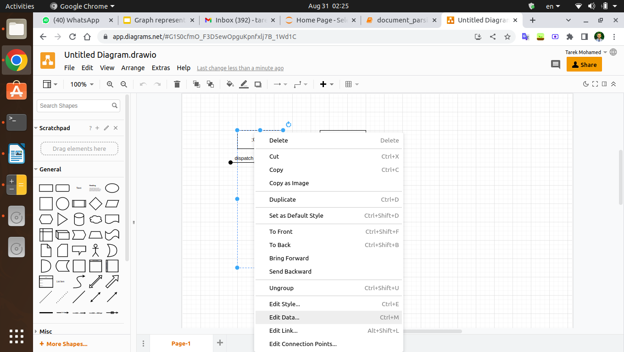
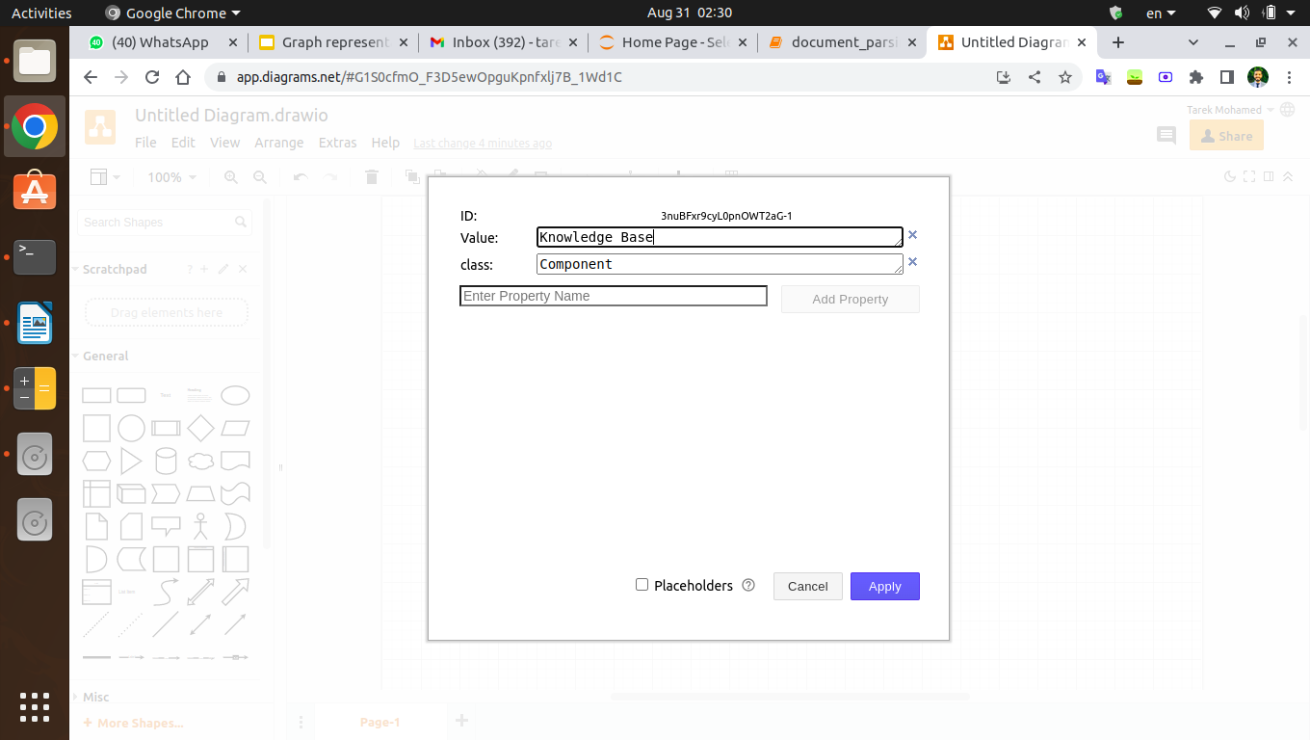
2.2 Draw.io
To use this tool we represented the graph on Draw.io tool and Customize it as follows:
For components:
Add a property “Value” and assign the name of the component to it.
Add a property “Class” and assign the type “Component” to it.
1. Add Data
2. Component Example

Slide 17
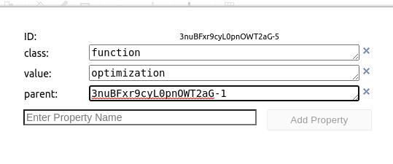
For Function:
Add a property “Value” and assign the name of the Function to it.
Add a property “Class” and assign the type “Function” to it.
Add a property “Parent” and assign the ID of the parent component.
2. Function Example

Slide 18
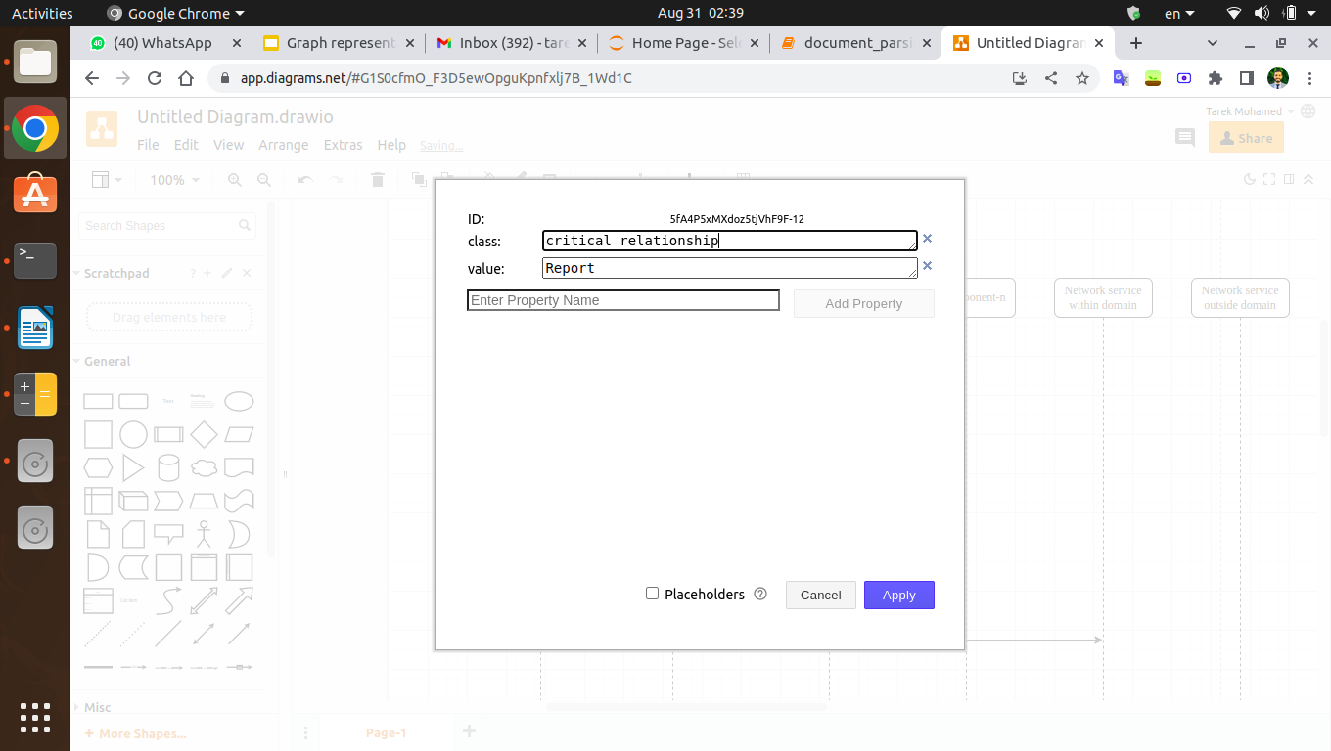
For Relations:
Add a property “Value” and assign the message of the relation to it.
Add a property “Class” and assign whether it was a critical or optional.
3. Relation Example

Slide 19
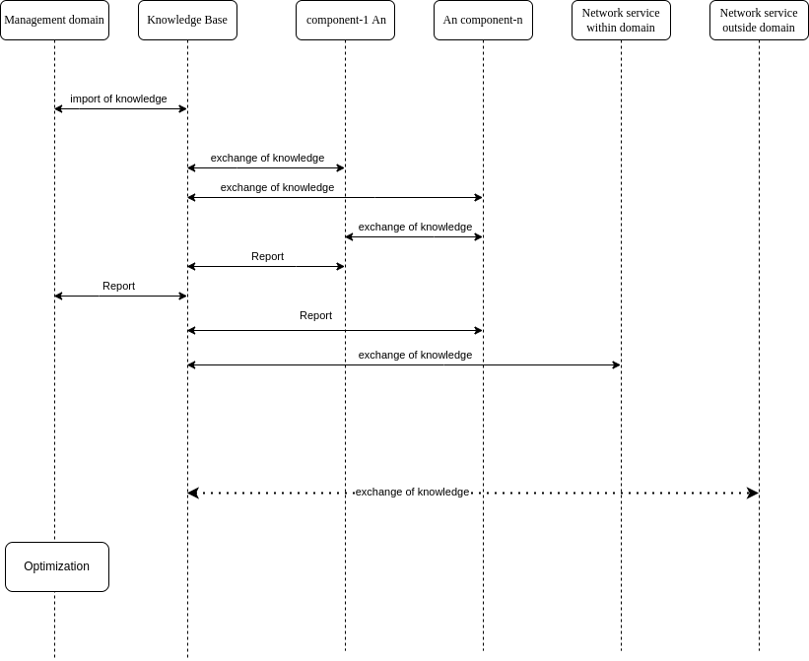
Final figure example:

Slide 20
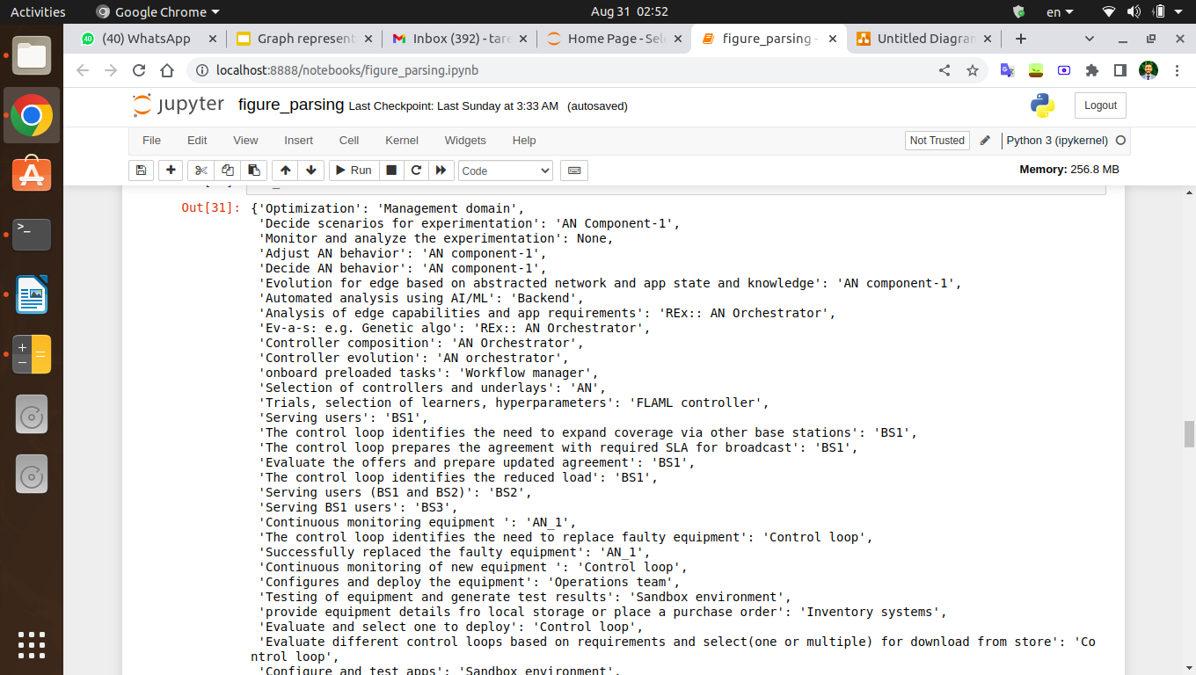
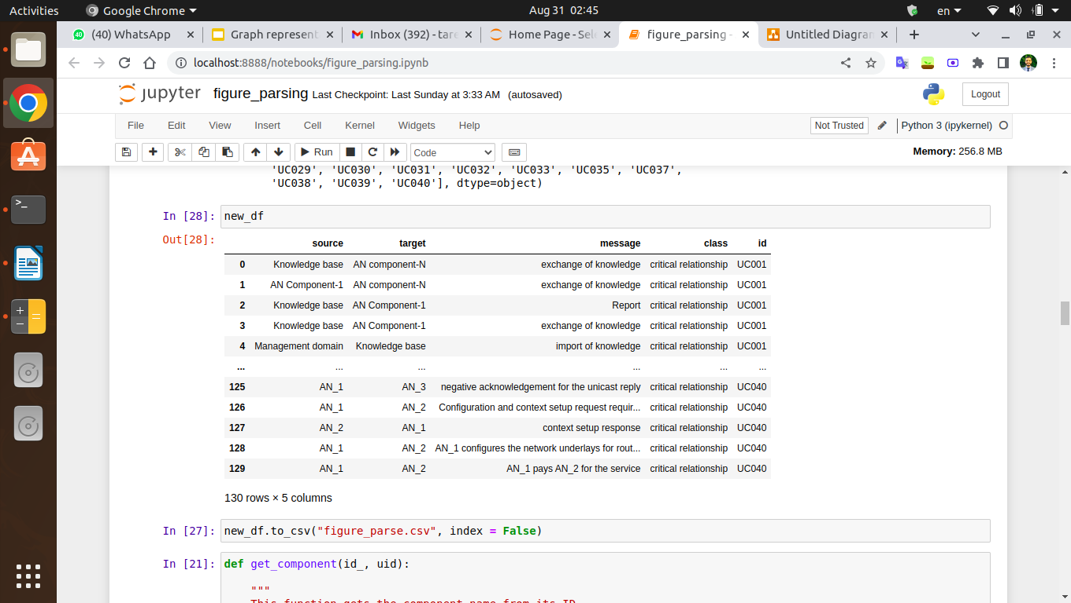
2.3 Parsing:
We used “XML” Library, and final parsing was:

Slide 21
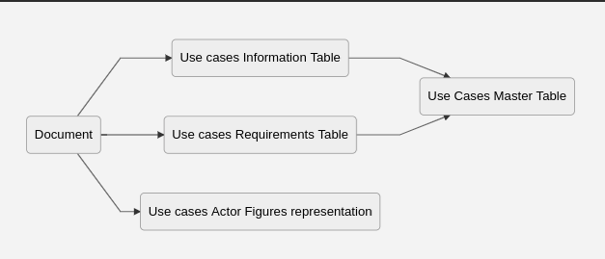

Slide 22
3. Graph database representation:
We have used “neo4j” Graph database because:
It has a native graph representation.
A lot of other packages especially on the data science.
Has its Querying language Cypher which help us in query graphs.
Finally Has an API with Python so it can help us automating our stuff.
Step-1: now that we have tables from use cases, requirements, figures, can we create a graph from the tables?
Step-2: to analyse the graph offline.

Slide 23
Important definition graph databases:
The data is represented on graph as follows:
Nodes: the main components of the graph and it must have:
Label(s)
[Optional] Other properties like “Functions” on our case
Edges or relations: these relations is the link between the nodes, and it must have:
Type of relationship.
[Optional] Other properties like “Message” and “use case id “in our case.

Slide 24
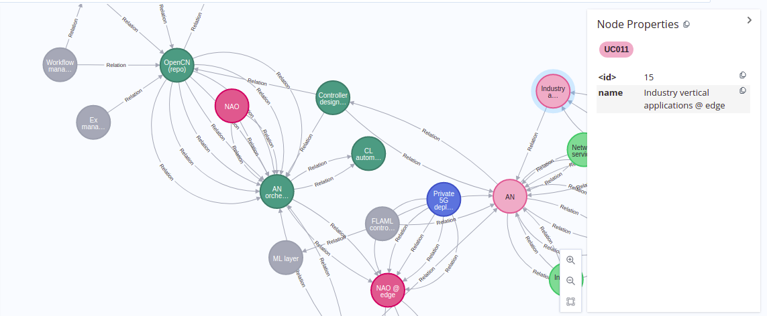
Our representation:
Using the reference code provided at https://github.com/vrra/FGAN-Build-a-thon-2022
I have implemented the following using Python API:
Subset of Graph database:

Slide 25
4. Link Prediction:
Step-2: to analyse the graph offline.
In Link prediction we want to predict links between nodes that aren’t found on the original graph, this is done by using “GDS” toolbox inside neo4j.
And to make so we need:
Make a pipeline.
Add some properties to the graph to represent different relative properties to the graph
Calculate Combined Features using some algorithms to indicate the whether there is a probability that a link is found between the pairs of nodes.
Split the data and Train the model candidates and choose the best

Slide 26
4.1 Pipelines:
Pipelines is a set of sequential instructions to do an END to END something
Our pipeline contains:
Making projections.
Preprocessing (Add node Properties, Add combined features)
Data Splitting.,
Training.

Slide 27
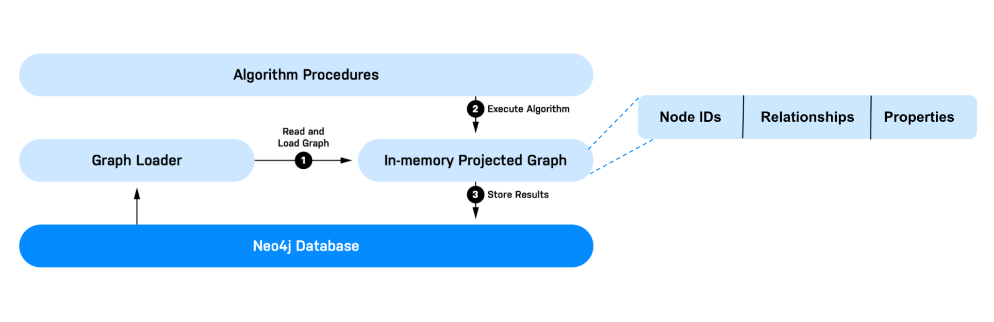
4.2 Projections and its importance:
We make a projection for our graph database with UNDIRECTED relationships.

Slide 28
4.3 Preprocessing steps:
4.3.1 Node Embeddings: (Node Property)
Node embedding algorithms compute low-dimensional vector representations of nodes in a graph. These vectors, also called embeddings, can be used for machine learning.
We have used FastRP algorithm because it’s the only one in production quality, and works in directed and undirected relationships.
“These algorithms are theoretically backed by the Johnsson-Lindenstrauss lemma according to which one can project n vectors of arbitrary dimension into O(log(n)) dimensions and still approximately preserve pairwise distances among the points. In fact, a linear projection chosen in a random way satisfies this property.”

Slide 29
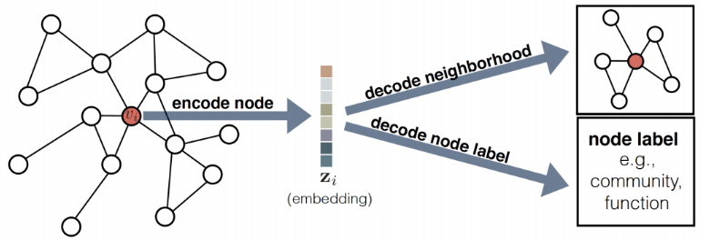

Slide 30
4.3.2 Centrality: (Node Property)
Centrality algorithms are used to determine the importance of distinct nodes in a network.
We have used Degree Centrality algorithm, as it works well in directed and undirected relationships.
degree centrality measures the number of incoming or outgoing (or both) relationships from a node, depending on the orientation of a relationship projection.

Slide 31
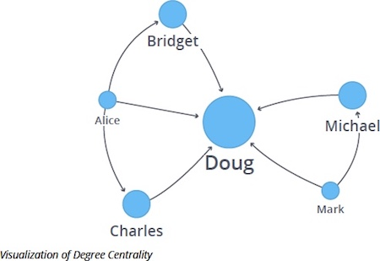

Slide 32
4.3.3 Community detection: (Node Property)
Community detection algorithms are used to evaluate how groups of nodes are clustered or partitioned, as well as their tendency to strengthen or break apart.
We have use Label propagation algorithm, as it works well for directed and undirected relationships.
The Label Propagation algorithm (LPA) is a fast algorithm for finding communities in a graph. It detects these communities using network structure alone as its guide, and doesn’t require a pre-defined objective function or prior information about the communities.

Slide 33
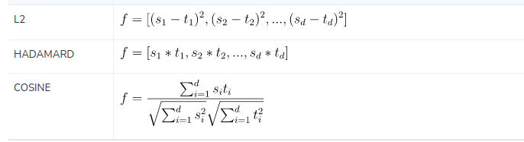
4.3.4 Combined Features:
We are using the properties that are created on nodes, and combine them in each potential link According to one of the following functions:

Slide 34
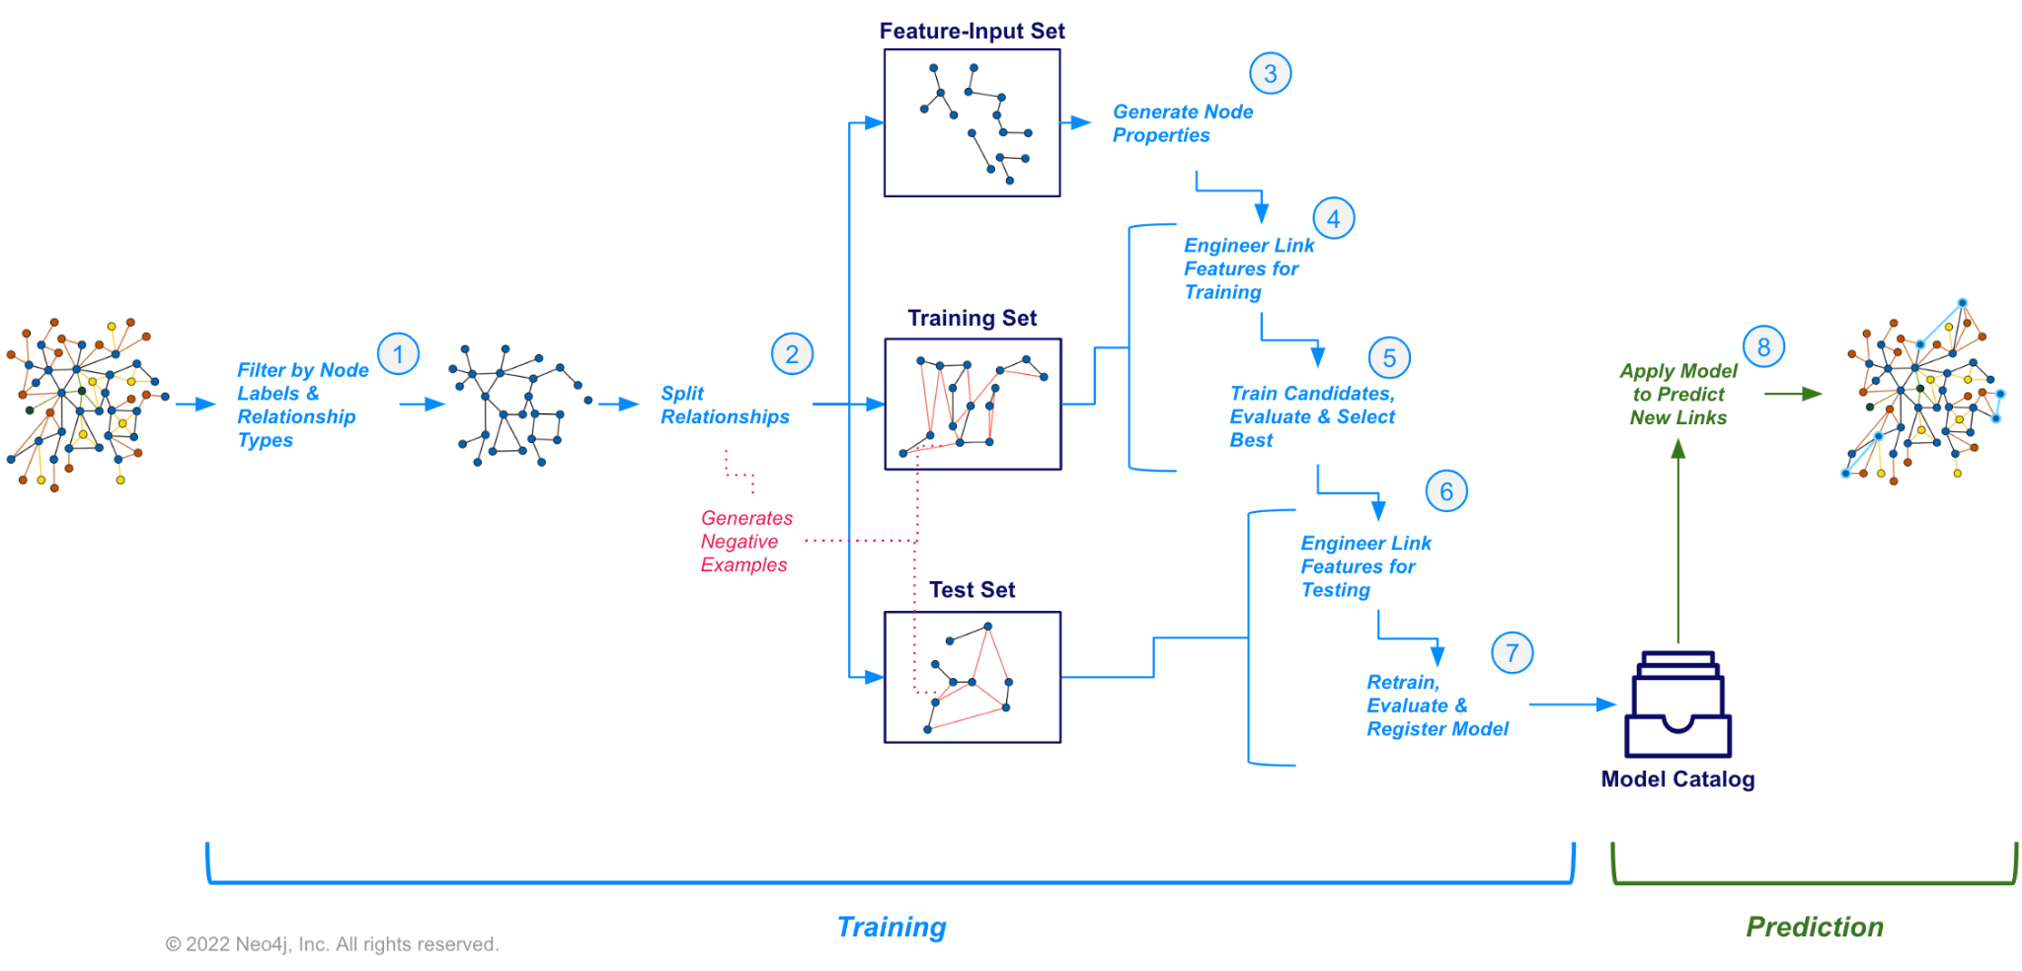
4.4 Splitting and training algorithms:

Slide 35
4.4.1 Splitting our dataset::
Our relationships is divided into Test and Train set according to test split.
A negative samples are added to each set.
Running the algorithms on both train and test and get the scores.

Slide 36
4.4.2 Algorithms:
Here we can consider the link prediction problem as a classification problem where we need to classify relationships into positive or negative relationships.
We have two candidates:
Logistic regression.
Random Forest.

Slide 37
4.4.3 Scores:
4.4.3.1 Scenarios:
First scenario: we use only the 130 relation data set, which is the result of using only use cases that have figures(From the document) on it.
Second scenarios: we use the full representation of the reference code, that have +500 relations and +300 Nodes.
Third scenario: we use the second scenario but we add the functions of the actors as properties in these nodes.

Slide 38
4.4.3.2 Results:
Representation | Best Model | Test Accuracy (AUCPR)
Scenario 1 | RF | 88 %
Scenario 2 | RF | 73.6%
Scenario 3 | RF | 86 %
We found 6954 new links with more than 99% of probability to be a true relation.

Slide 39
Next Steps and Recommendation:
Manipulate the graph and study and analyse the effects.
Optimize the graph representation to have only the main actors and include the rest of information as node properties.
Using Different Algorithms to have better accuracy like Graph neural networks or graph convolutional neural networks.
Node Property Predictions.
[Document Enhancements] Updating the graphs in the word file to be all in the same format and parsable, instead of images.
[Document Enhancements] Updating the table fields to have all a constant field name.
Any other feedback from the group?

Slide 40
References:
[FGAN-use cases] ITU-T Focus Group Autonomous Networks Technical Specification “Use cases for Autonomous Networks” https://www.itu.int/en/ITU-T/focusgroups/an/Documents/Use-case-AN.pdf
[Build-a-thon 2022] https://github.com/vrra/FGAN-Build-a-thon-2022
[FG AN Arch framework] Architecture framework for Autonomous Networks, https://www.itu.int/en/ITU-T/focusgroups/an/Documents/Architecture-AN.pdf
[Link Prediction] Link Prediction pipeline, neo4j, https://neo4j.com/docs/graph-data-science/current/machine-learning/linkprediction-pipelines/link-prediction/
[Neo4j Graph database] Neo4j, Graph database, https://neo4j.com/
[PlantUML] PlantUML tool to represent figures, http://www.plantuml.com/plantuml/uml/SyfFKj2rKt3CoKnELR1Io4ZDoSa70000
[XML] XML, python library to process xml files, https://docs.python.org/3/library/xml.html
[Python Docx] Docx, A python library to process word documents, https://python-docx.readthedocs.io/en/latest/
[Diagrams.net] Diagrams.net, Online flowchart and diagrams maker, https://app.diagrams.net/
[Python] Python programming language.
[Presentation] InnovNet Final presentation, https://docs.google.com/presentation/d/1LubX__7ZXCu6qWEd6vR3fKIhABMCey7MZocPNpEs2IQ/edit?usp=sharing
[Github Repo for the code] Codes and reports Github repo, https://github.com/TarekMohamed1999/FGAN-build-a-thon

Slide 41
Thanks!

